Slide 1
Time Series Data Mining Review
Author: Sun Zhao
Email: zixiaojindao@gmail.com

Slide 2
Mining Data Streams
Process of extracting knowledge structures from continuous, rapid data records.
Computer network traffic, phone conversations, ATM transactions, web searches, and sensor data.
One pass constrain.
Temporal evolution, historical data may be updated.

Slide 3
Theoretical Foundations[1]
Data-based techniques(summarize data set)
Sampling
Load shedding
Sketching
Aggregation
Task-based techniques(address computational challenges)
Approximation algorithms
Sliding Window
Algorithm Output Granularity

Slide 4
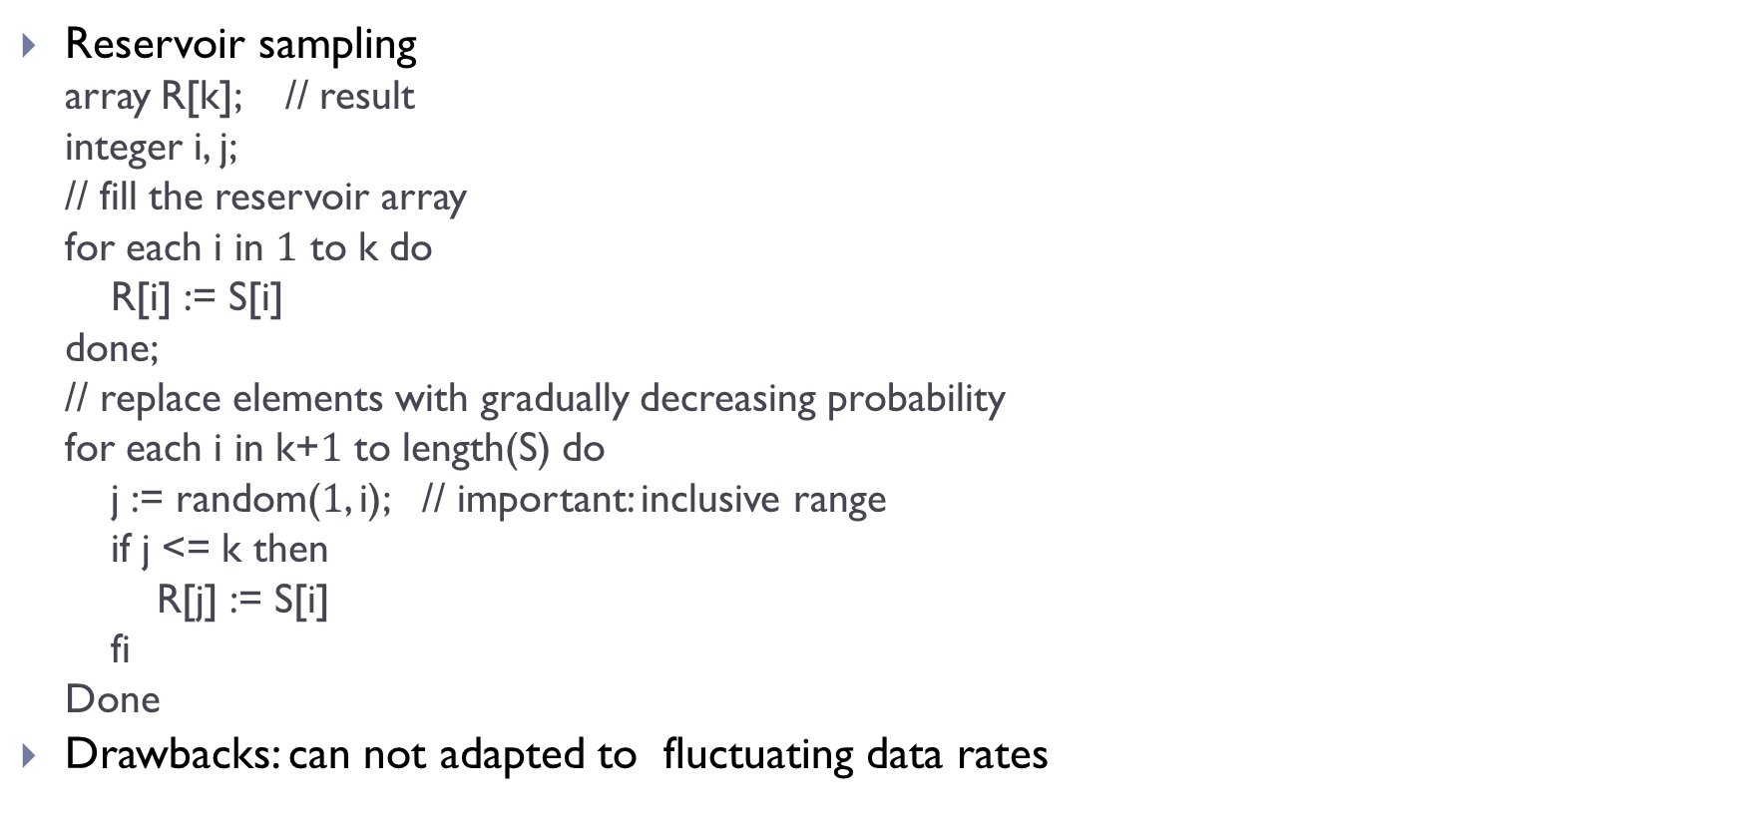
Sampling
Reservoir sampling
array R[k]; // result
integer i, j;
// fill the reservoir array
for each i in $1$ to k do
R[i] := S[i]
done;
// replace elements with gradually decreasing probability
for each i in k+$1$ to length(S) do
j := random($1$, i); // important: inclusive range
if j <= k then
R[j] := S[i]
fi
Done
Drawbacks: can not adapted to fluctuating data rates

Slide 5
Load Shedding[2]
Determine when to shed load
Determine where to she load
Determine how much load to shed
Drawbacks: drop potential patterns

Slide 6
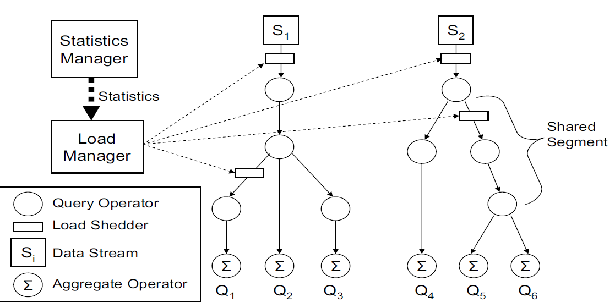
Load Shedding
Determine when to shed load
Determine where to she load
Determine how much load to shed
Drawbacks: drop potential patterns

Slide 7
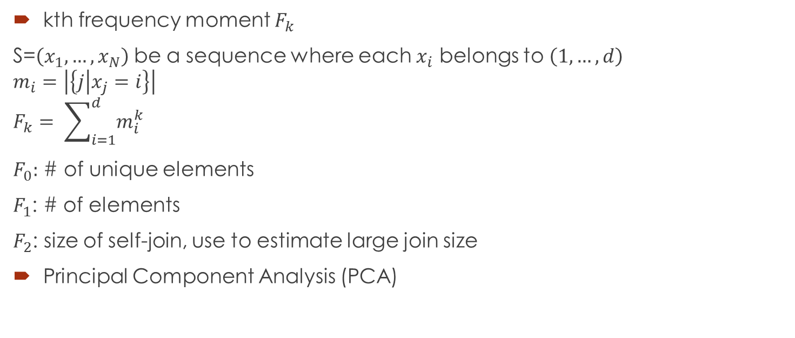
Sketching
kth frequency moment $F_{k}$
S=$\left(x_{1},…,x_{N}\right)$ be a sequence where each $x_{i}$ belongs to $\left(1,…,d\right)$
$$m_{i}=\left|\left\{j | x_{j}=i\right\}\right|$$
$$F_{k}= \sum_{i=1}^{d}{m_{i}^{k}}$$
$F_{0}:$ # of unique elements
$F_{1}$: # of elements
$F_{2}$: size of self-join, use to estimate large join size
Principal Component Analysis (PCA)

Slide 8
Synopsis Data Structures & Aggregation
Synopsis Data Structures
Wavelet analysis
Histograms
Quantiles
frequency moments
Aggregation
Means
Variances
Other statistical aggregated data

Slide 9
Pros & Cons
Data-Based:
Techniques | Definitions | Pros | Cons
Sampling | Choosing a data subset for analysis | Error Bounds Guaranteed | Poor for anomaly detection
Load Shedding | Ignoring a chunk of data | Efficient for queries | Very poor for anomaly detection
Sketching | Random projection on feature set | Extremely Efficient | May ignore Relevant features
Synopsis Structure | Quick Transformation | Analysis Task Independent | Not sufficient for very fast stream
Aggregation | Compiling summary statistics | Analysis Task Independent | May ignore Relevant features

Slide 10
Pros & Cons
Task-Based:
Techniques | Definitions | Pros | Cons
Approximation Algorithms | Algorithms with Error Bounds | Efficient | Resource adaptivity with data rates not always possible
Sliding Window | Analyzing most recent streams | General | Ignores part of stream
Algorithm Output Granularity | Highly Resource aware technique with memory and fluctuating data rates | General | Cost overhead of resource aware component

Slide 11
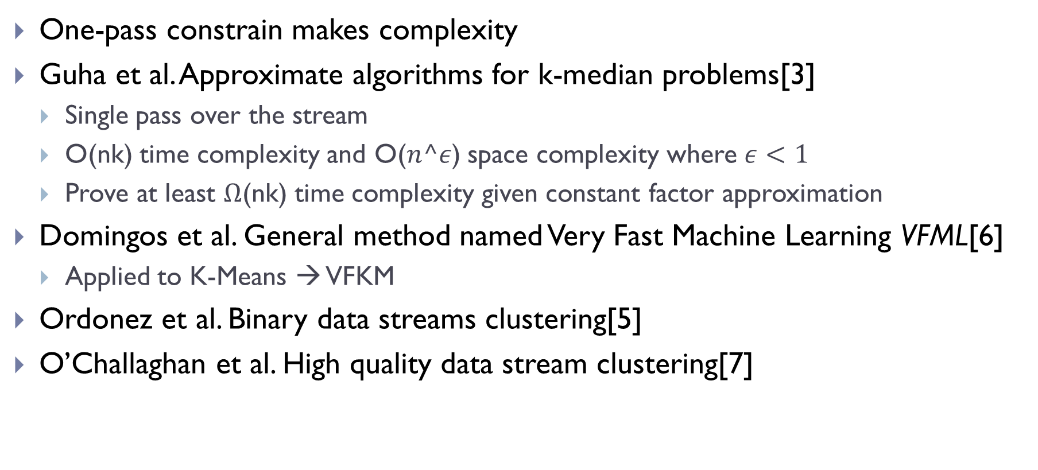
Data Stream Clustering[4]
One-pass constrain makes complexity
Guha et al. Approximate algorithms for k-median problems[3]
Single pass over the stream
O(nk) time complexity and O($n^ε$) space complexity where $ε<1$
Prove at least $Ω$(nk) time complexity given constant factor approximation
Domingos et al. General method named Very Fast Machine Learning VFML[6]
Applied to K-Means → VFKM
Ordonez et al. Binary data streams clustering[5]
O’Challaghan et al. High quality data stream clustering[7]

Slide 12
Data Stream Classification[8]
High speed nature of data streams : The rate of building a classification model should be higher than the data rate
Bounded memory requirements: load shedding, sampling, aggregation, and creating data synopsis
Concept Drifting: Models become stale and less relevant over time. Ensemble based classification for voting a best prediction
Challenges in Distributed Applications: Large mounts mining result sent to users in a limited bandwidth environments. Addressed by DFT methods
Modeling change of mining results over time: Users are interested in modeling changes over a temporal basis

Slide 13
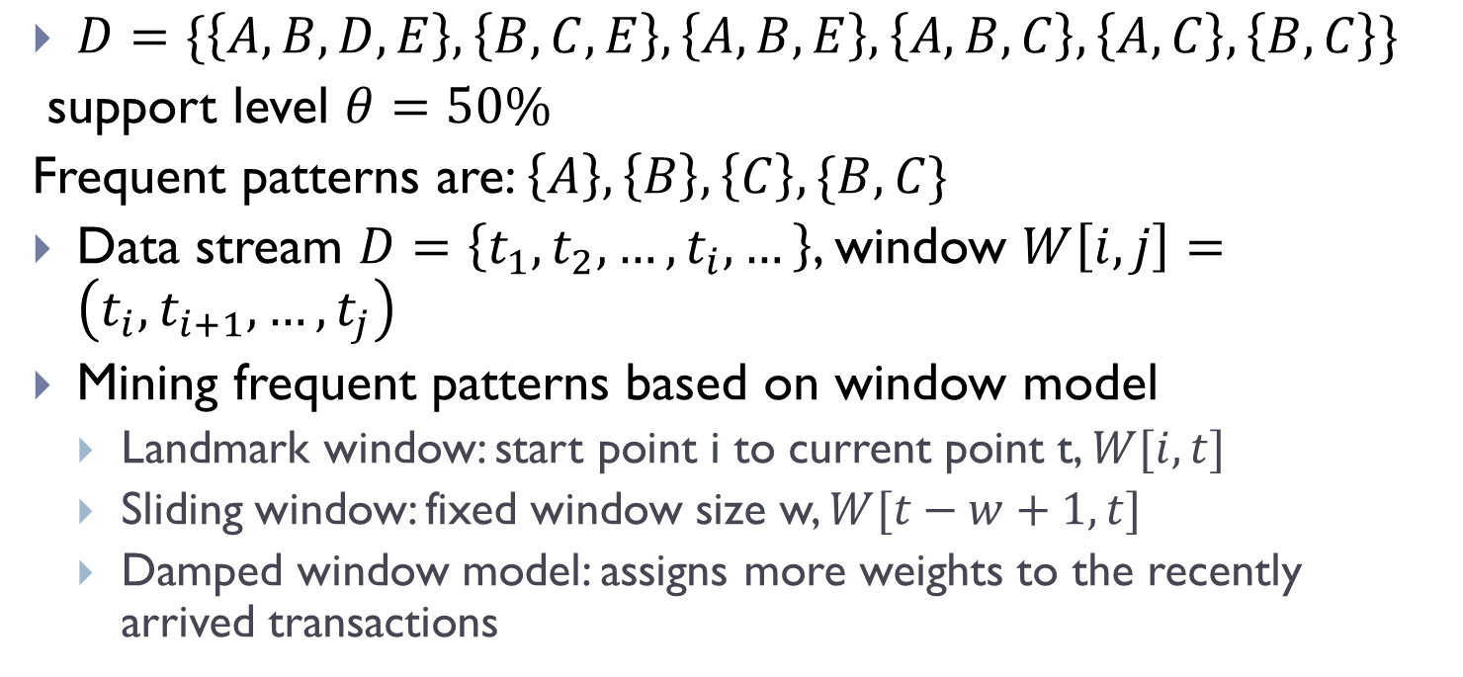
Data Stream Frequent pattern Mining
$D=\{\left\{A,B,D,E\right\}, \left\{B,C,E\right\}, \left\{A, B, E\right\}, \left\{A, B, C\right\}, \left\{A, C\right\}, \left\{B, C\right\}\}$
support level $θ=50\%$
Frequent patterns are: $\left\{A\right\}, \left\{B\right\}, \left\{C\right\}, \{B,C\}$
Data stream $D=\left\{t_{1}, t_{2},…,t_{i},…\right\}$, window $W\left[i,j\right]=\left(t_{i},t_{i+1},…, t_{j}\right)$
Mining frequent patterns based on window model
Landmark window: start point i to current point t, $W[i,t]$
Sliding window: fixed window size w, $W[t−w+1, t]$
Damped window model: assigns more weights to the recently arrived transactions

Slide 14
References
[1] Gaber M M, Zaslavsky A, Krishnaswamy S. Mining data streams: a review[J]. ACM Sigmod Record, 2005, 34(2): 18-26.
[2] Babcock B, Datar M, Motwani R. Load shedding for aggregation queries over data streams[C]//Data Engineering, 2004. Proceedings. 20th International Conference on. IEEE, 2004: 350-361.
[3] Guha S, Mishra N, Motwani R, et al. Clustering data streams[C]//Foundations of computer science, 2000. proceedings. 41st annual symposium on. IEEE, 2000: 359-366.
[4] Gaber M M, Zaslavsky A, Krishnaswamy S. Mining data streams: a review[J]. ACM Sigmod Record, 2005, 34(2): 18-26.
[5] C. Ordonez. Clustering Binary Data Streams with K-means ACM DMKD 2003
[6] Domingos P, Hulten G. A general method for scaling up machine learning algorithms and its application to clustering[C]//MACHINE LEARNING-INTERNATIONAL WORKSHOP THEN CONFERENCE-. 2001: 106-113.

Slide 15
References
[7] O'callaghan L, Mishra N, Meyerson A, et al. Streaming-data algorithms for high-quality clustering[C]//Data Engineering, 2002. Proceedings. 18th International Conference on. IEEE, 2002: 685-694.
[8] Aggarwal C C. Data streams: models and algorithms[M]. Springer Science+ Business Media, 2007.

Slide 16
Above materials and slides: https://github.com/zixiaojindao/time-series-survey.git
Thanks!

